Slide 1
Security Models
Gerhard Steinke

Slide 2
Security
CIA
Confidentiality
Integrity
Availability
Mandatory Security Model
Discretionary Security Model
Data Classification Matrix
Ethical Issues

Slide 3
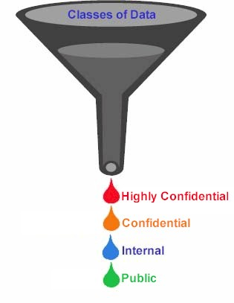
Mandatory Security Model
Also called multilevel security
Hierarchical model
Clearance levels assigned to subjects (users)
Security levels assigned to objects
Access depends on relationship between clearance level and security level
Military application
e.g., public, confidential, secret, top-secret

Slide 4
Bell and LaPadula Security Model
Bell and LaPadula Security Model
simple security property - no reading up
*-property - no writing down
Problems
static security levels
Need breakdown by department/division
lack of flexibility
trusted user

Slide 5
Discretionary Security Model
Subject, object, access type
Access matrix
Various types of access
Owner grants access permission
Basis for Discretionary Security
Access at the discretion of the owner
Need-to-know
Permission to a group, role or task

Slide 6
Access Matrix Model
Objects
Name
Salary
Position
S
u
b
j
e
c
t
s
own
r
Joe
Jack
r
own
r
own
w
Jill

Slide 7
Data Classification Matrix
Classification
Category A
(Highest, most sensitive)
Category B
(Moderate level of sensitivity)
Category C
(Very low, but still some sensitivity)
Legal requirement
Protection of data is required by law (see attached list for specific HIPAA and FERPA data elements)
contractual obligation to protect the data
Reputation risk
High
Medium
Low
Examples
Medical, Personnel
Donor or prospect
Financial, Contracts
Credit Card numbers
Financial transactions which do not include Category-A data (e.g., telephone billing)
Email list?

Slide 8
Another Data Classification Matrix
Classification
Operational/
Eligible for Public Release
Confidential
Restricted
Definition
Available to employees for normal operational use. Available to the public based on appropriate request for disclosure of information.
Information that the organization employees have a legal, regulatory, or social obligation to protect.
Information intended solely for restricted use within the organization and is limited to those with an explicit, predetermined "need to know". Disclosure could result in severe personal or financial damage to individuals or organization
Examples
General financial data
directory data (non-opt out)
Non-confidential personnel data
Email addresses
Employee ID
Employee benefit information
non-directory information
SSN
Passwords/PINS
Credit card numbers
Digitized signatures
Encryption keys
Medical Records

Slide 9
Security Policies and Procedures

Slide 10
Security Policy Requirements
Set of rules, principles that prescribe security requirements/expectations in an organization.
Based on legal requirements, organizational goals and philosophy
Board approval and support
Define sanctions, where actual prevention is not technically feasible
Clearly define the areas of responsibility for users, administrators, and managers
Be communicated to all
Followed up with standards, procedures, practices, guidelines,…

Slide 11
Standards, Procedures, Guidelines
Implementation of Security Policy
Security Standards
Hardware, software, products
Security Procedures
Methods of implementing security
Step by step
Platform/application specifics
System assessment process
System development process
Security Guidelines
Recommendations, suggestions for specific environments

Slide 12
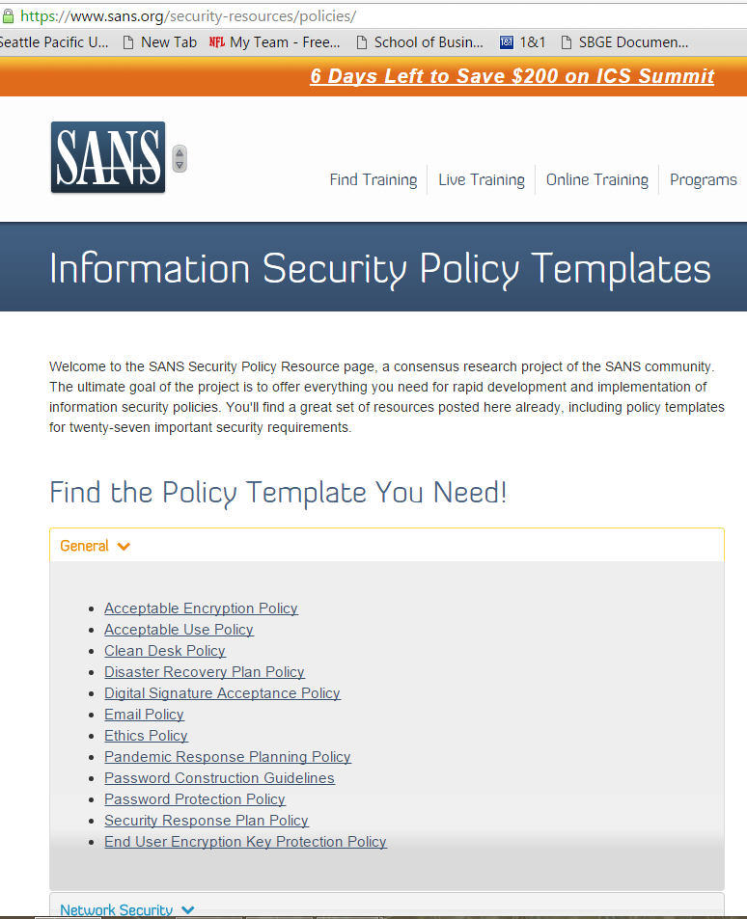
https://www.sans.org/security-resources/policies/

Slide 13
Government Security Policy Considerations
Legal requirements
Due diligence
Government / citizen expectations
Privacy expectations
https://www.washingtonpost.com/technology/2021/08/29/facebook-privacy-monopoly/
https://www.nytimes.com/wirecutter/blog/state-of-privacy-laws-in-us/
https://oag.ca.gov/privacy/ccpa
https://www.businessinsider.com/what-is-section-230-internet-law-communications-decency-act-explained-2020-5
International environment
https://ec.europa.eu/info/law/law-topic/data-protection_en
https://gdpr-info.eu/
https://www.enforcementtracker.com/
https://www.forbes.com/sites/forbestechcouncil/2022/02/01/is-it-time-for-a-us-version-of-gdpr/?sh=57d6d567637a
http://www.networkworld.com/article/3020031/security/will-the-european-unions-new-general-data-protection-regulation-impact-your-business.html

Slide 14
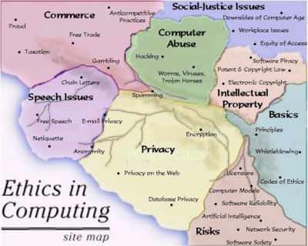
Ethical Issues
http://ethics.csc.ncsu.edu/

Slide 15
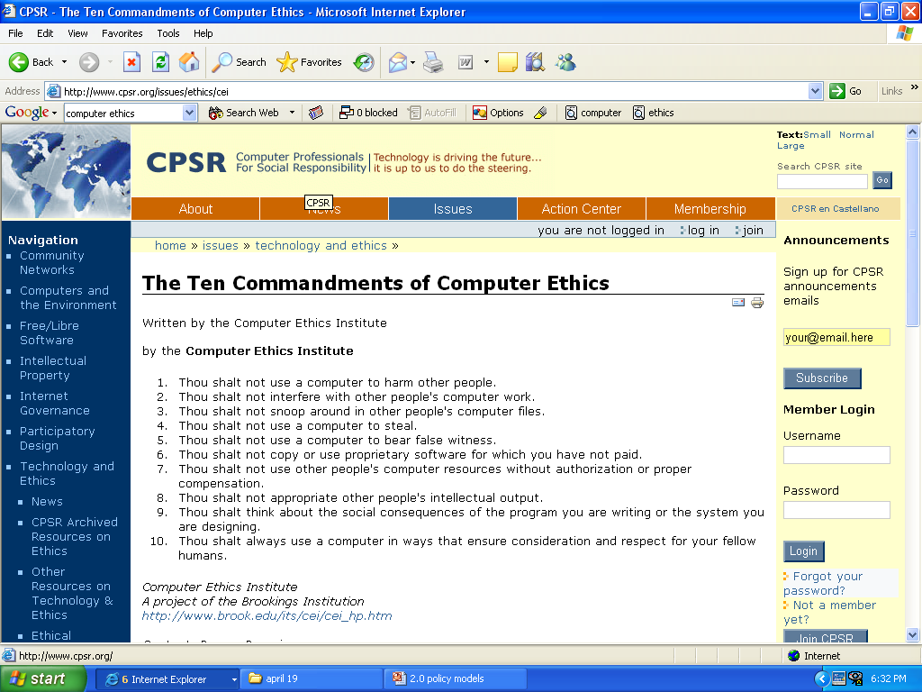
Ethical Issues

Slide 16
Security Awareness and Education
Gerhard Steinke

Slide 17
Security Awareness
Marketing, public relations, advertising, educating, training
Educating employees, citizens
to know security policy, expectations
to the types of security issues and incidents may arise
to prevent security incidents
to know what actions to take in case of security breach

Slide 18
Goal of Security Awareness
Reduce security incidents
More secure information systems
Show value of information
Raise security consciousness
Understand existing policies, methods and procedures
Procedures to follow when violation occurs

Slide 19
Security Awareness – Who?
New employees
Employees who change roles
Partners, suppliers,contractors,…
Customers, users
Citizens, everyone

Slide 20
Security Awareness – How?
Identify different population segments
Different presentations/approaches to different segments
Refreshers, reminders, updates

Slide 21
Security Awareness Themes
Be aware
Know how to identify a potential issue
Know impact of a compromised computer
Learn and practice good security habits
Incorporate secure practices into everyday routine
Encourage others to do so as well
Report anything unusual
Know contact points
Notify the appropriate contacts if aware of a suspected security incident

Slide 22
Security Awareness Techniques
Presentations
Videos, on the web
Posters
Booklets, postcards
Newsletters, articles in internal publications
Special alert memos, emails, websites
Handouts, trinkets – cups, mouse pads,…
Contests

Slide 23



Posters
.

Slide 24
Creating a Security Awareness Program
Obtain senior management support
Evaluate problem areas
Identify audience
Identify basic program content/emphasis
Design awareness tools
Implement
Measure effectiveness – surveys, audits\
Ongoing

Slide 25
Awareness/Training Issues
Awareness for executives
Use of horror stories
Legal threats
Planned penetrations
Social engineering
When a disaster hits or security incident occurs - Be ready!

Slide 26
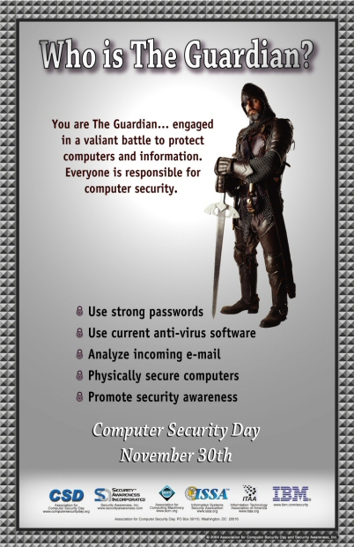

Goal: Awareness Mindset
https://www.sans.org/security-awareness-training/?msc=home-card-gallery

